Slide 1
UCLA/Salesforce Data Science Challenge
Team 6
Aug. 31, 2017
Spencer Bujarski Tsang-Kai Chang
Gina Charusombat
Yuan Yi Chen
Yeou Chiou
Hubert Jenq
Notes:
Modify whatever you like

Slide 2
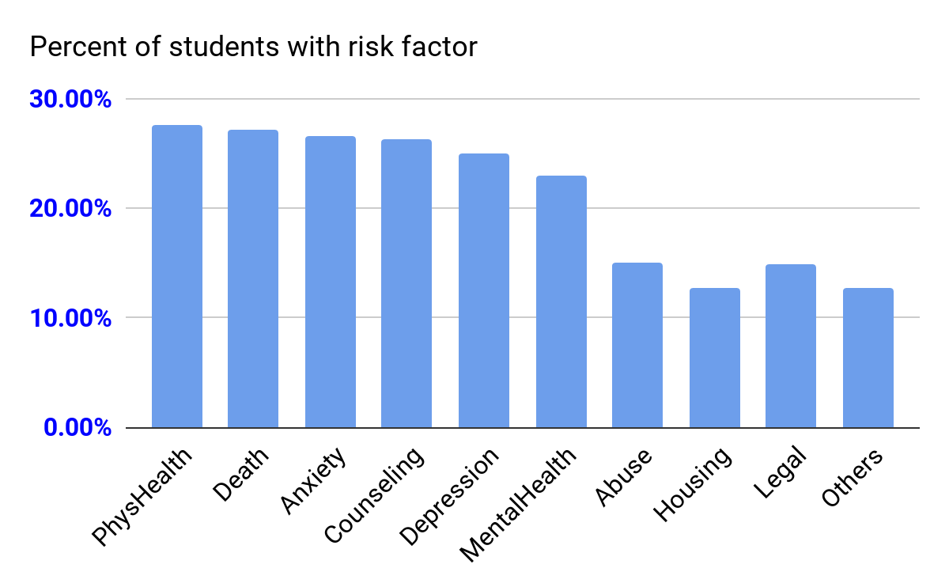
Summary stats
Low attendance rate 43.2%
Low class pass rate 60%
Low graduation rate 15%
Low counseling rate 23.2%
Notes:
Current students 38.9% overall student attendance rate (incl drop/grad)

Slide 3
How do various predictors affect attendance, competencies/test scores, and most importantly graduation?
Are the counseling interventions working, and if so, for whom?

Slide 4
Attendance

Slide 5
Attendance Analysis
Student Factor Prediction
Risk (Physical Health, Recent Death of Close Other, Anxiety, Depression, Abuse, Housing, Employed, and Other)
Demographics (Gender and Race)
Education Variables (Special Education, Number of Exemptions, and Far/Close Designation)
Time-Dynamic Analysis
We explore whether advisor interventions are effective in raising the attendance rate.

Slide 6
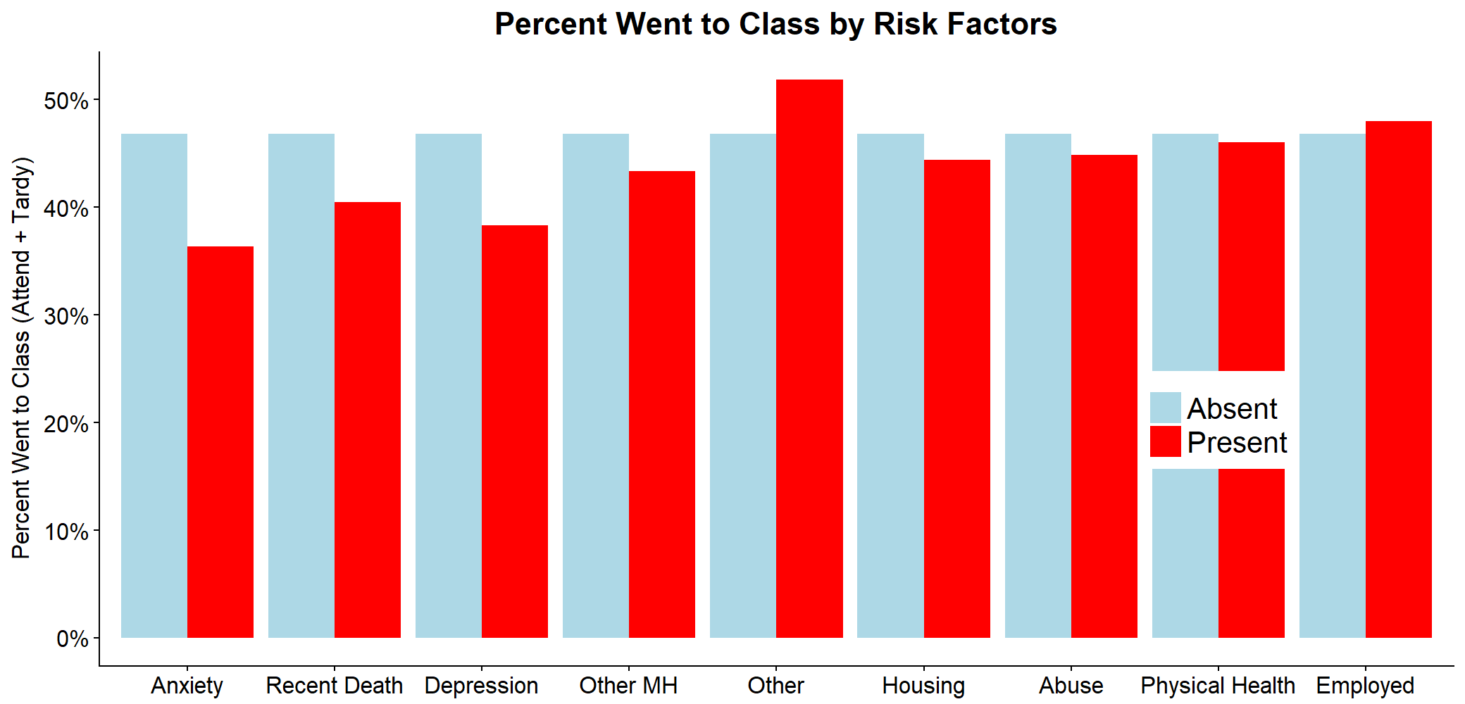
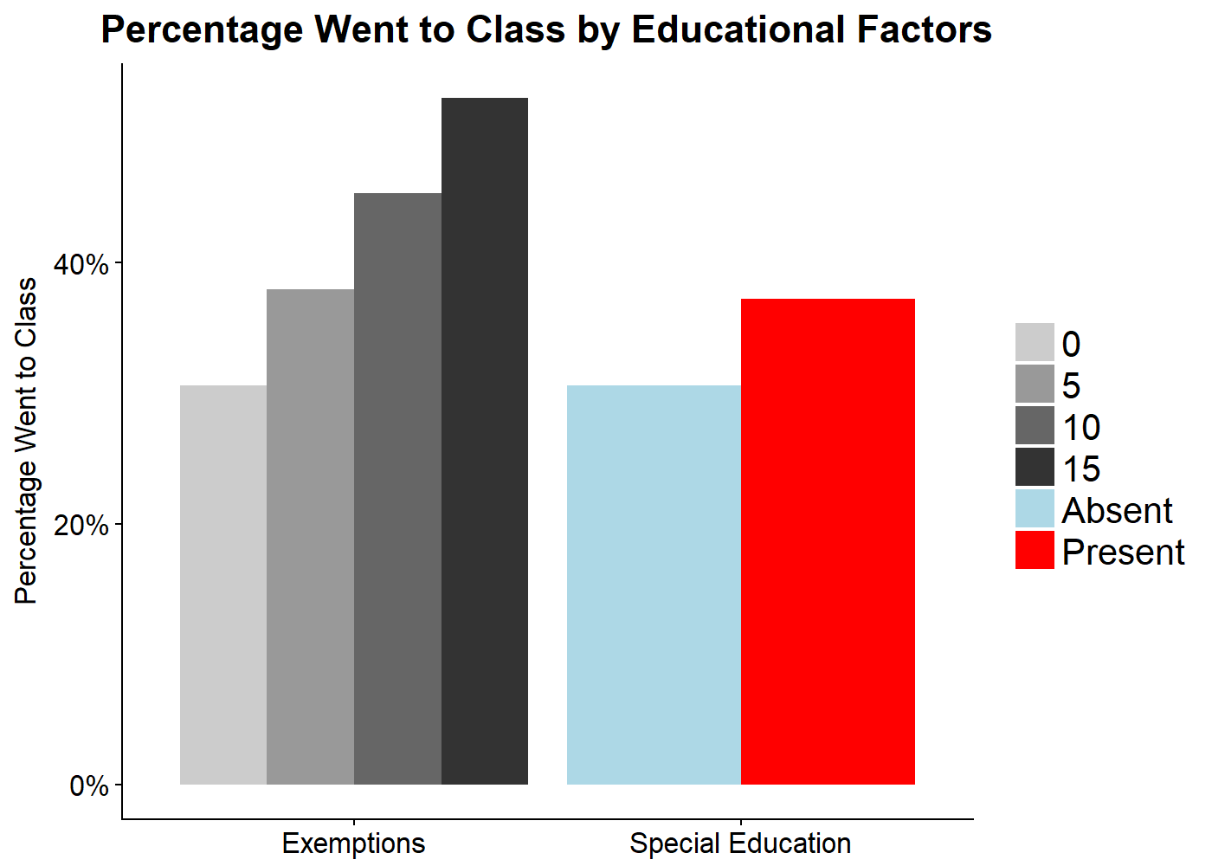
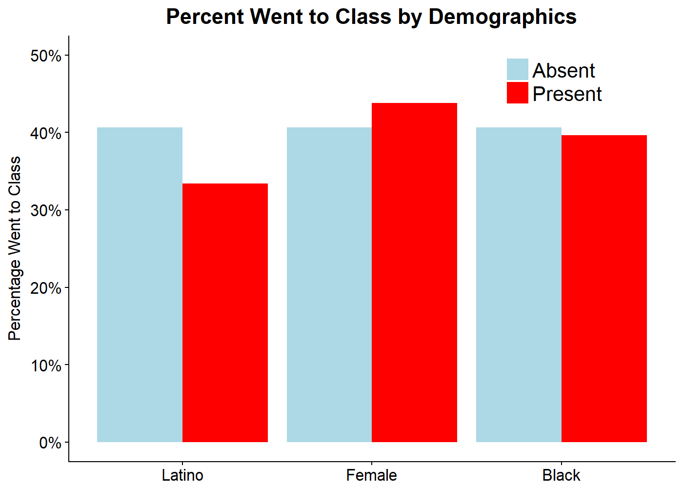
Do Student Factors Predict Class Attendance?
Notes:
3 plots -> 3 categories
Ordered by significance

Slide 7
Dynamic Bayesian Network
We consider the effect of intervention on the attendance.
The effect is assumed to be stationary, which means that the mechanism is invariant along the time.
intervention
t-1
t
class attendance rate: High/Medium/Low
Notes:
Consider intervention/attendance rate by trimester

Slide 8
Intervention Analysis Result
 | To High | To Medium | To Low
From High | 89 (47.3%) | 86 (45.7%) | 13 (6.9%)
F. Medium | 19 (6.2%) | 141 (45.8%) | 148 (48.1%)
F. Low | 3 (2.1%) | 15 (10.5%) | 125 (87.4%)
Downward drift
No intervention
With intervention
 | To High | To Medium | To Low
From High | 89 (47.3%) | 86 (45.7%) | 13 (6.9%)
F. Medium | 13 (4.8%) | 132 (49%) | 124 (46%)
F. Low | 3 (2.6%) | 12 (10.2%) | 102 (87.1%)
To High | To Medium | To Low
0 | 0 | 0
6 (15.4%) | 9 (23.1%) | 24 (61.5%)
0 | 3 (11.5%) | 23 (88.4%)
Notes:
Downdrift

Slide 9
Test Scores & Class Competencies

Slide 10
Which Features Predict Competency?
Two co-primary outcomes
Competency in courses - “Success” is highly competent or competent
MCAS scores - Average of English Language, Mathematics, and Science
Random forest analysis and lasso regression used to examine many factors
Risk Factors: Depression, Anxiety, Recent Death, etc.
Demographics: Race, Gender, Zip code, etc.
Services: SNAP, Section 8, etc.
Classes: Specific classes taken

Slide 11
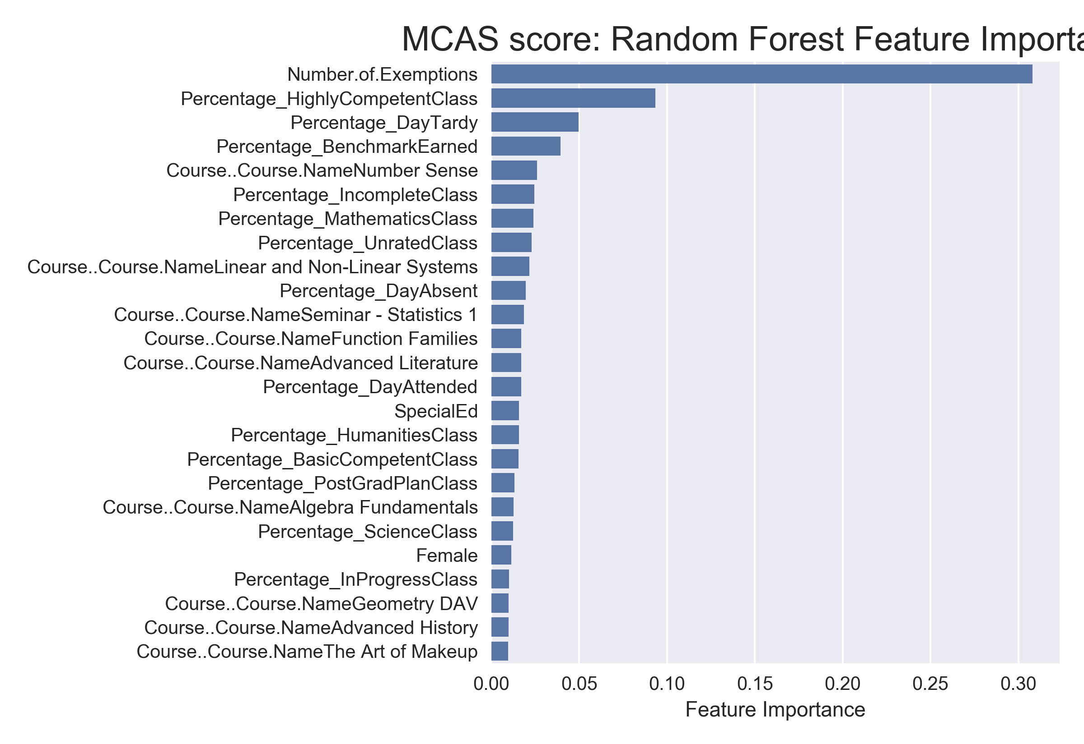
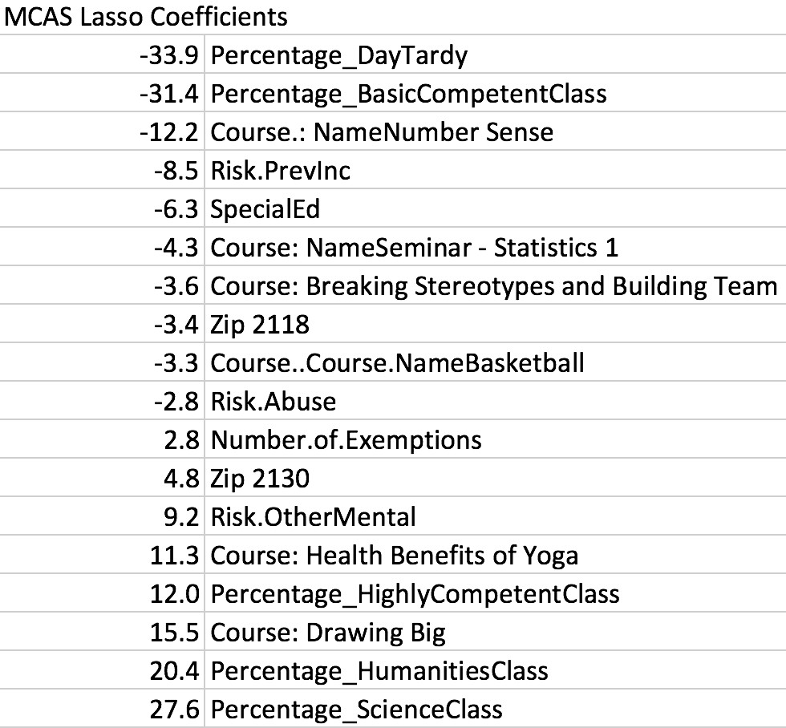
MCAS Scores
Factors to Consider:
Number of exemptions
Days Tardy
Why specific courses?
Number Sense, Yoga, Drawing Big
Zip codes 2118
Training:80% (143) , Test:20% (36)
Lasso Test: R^2=0.62, RMSE=23.1
RF Test: R^2=0.52, RMSE=25.7
Notes:
-total num features ~ 170
-Lasso 5-fold CV to pick best alpha
-RF 500 trees, mtry=.33%, min tree sample = 5, max depth = 7
-RF feature importance is calculated by how often it is selected in trees (GINI importance).

Slide 12
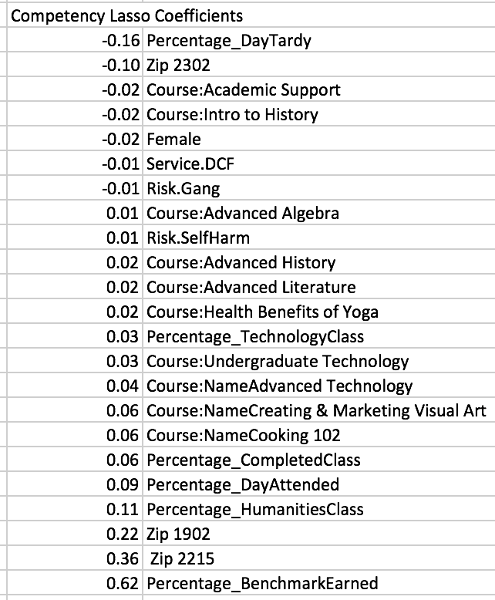
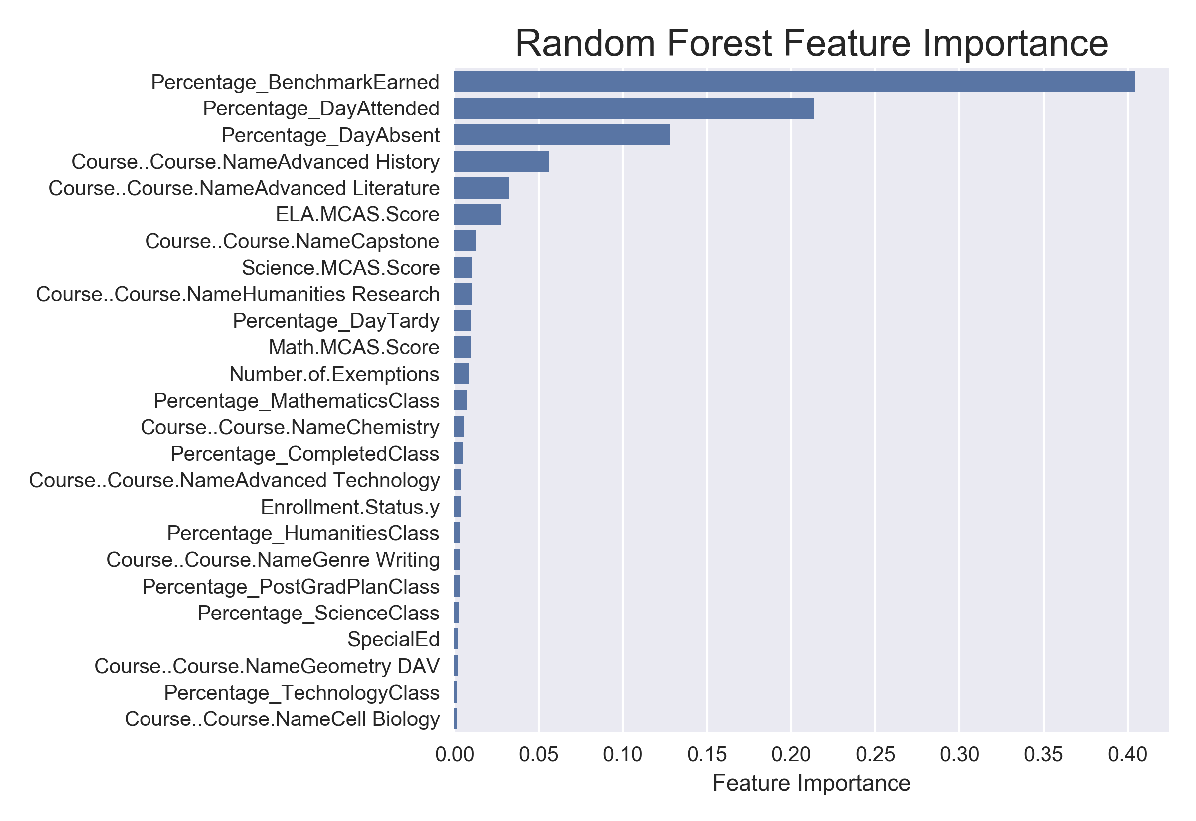
Competencies
Factors to Consider:
Benchmarks earned
Attendance and Absences
Zip code 2302
Training:80% (309) , Test:20% (77)
Lasso Test: R^2=0.86, RMSE=0.09
RF Test: R^2=0.82, RMSE=0.10

Slide 13
Graduation
Notes:
Eve’s notes: So after we know what features may influence student’s attendance, competencies, scores. We want to know is there any early warning signs for students’ to quit their studies.

Slide 14
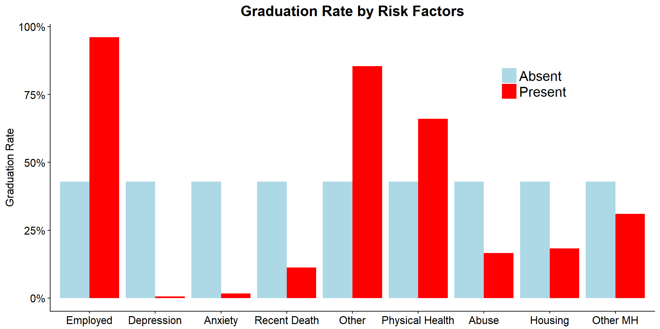
Early Warning Signs for Problematic Situation
Students with depression are only 0.87% as likely to graduate
With anxiety only 2.3% as likely to graduate
Notes:
Even though we know the risk has played a crucial part of whether a student will complete their degree or not, we want to know more details about what kind of risks influence students to discharge. We split risks into different part, and we apply logistic regression on them. Although we saw that students who suffered from risk of death tend to discharge their studies, but actually, anxiety and depression have much more significant impact on their studies.
2. Example: I have anxiety
3. Pay much more attention on student’s mental health, e.g. promote more counseling programs like UCLA does

Slide 15
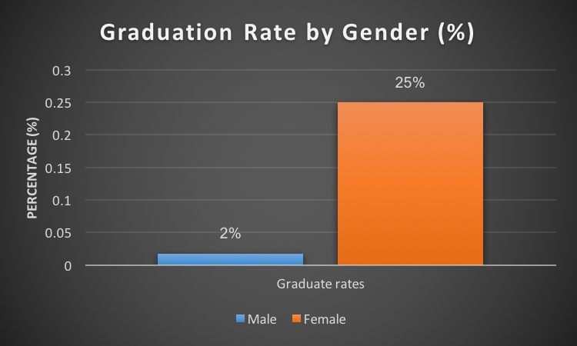
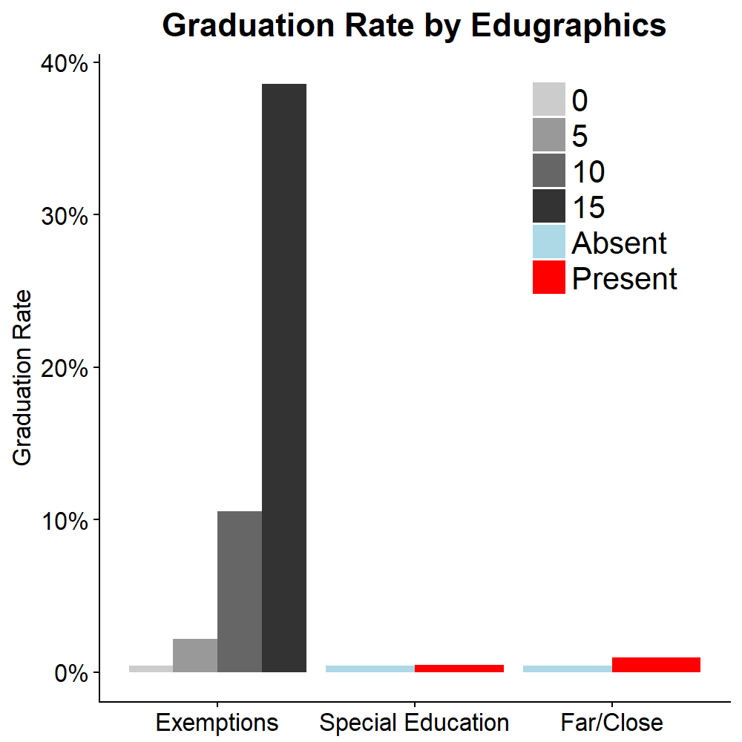
The Commonalities of Success Stories
Education
Females: females is 13.9 times that of males
Numbers of Course Exemptions: 1.4 times more odds for he/she to graduate
Notes:
Analyze the commonalities of students who successfully graduate.
Demographic - The odds of graduating for females is 14 times that of males.
Educational background: Every one more additional exemptions make people 1.4 times more likely to graduate

Slide 16
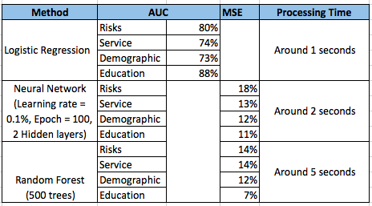
Analyze Graduation Rate by Different Models
Notes:
Last thing, we assume our models will be applied to new students’ data for school to predict their graduation rate.

Slide 17
Counseling
Notes:
Eve’s notes: So after we know what features may influence student’s attendance, competencies, scores. We want to know is there any early warning signs for students’ to quit their studies.

Slide 18
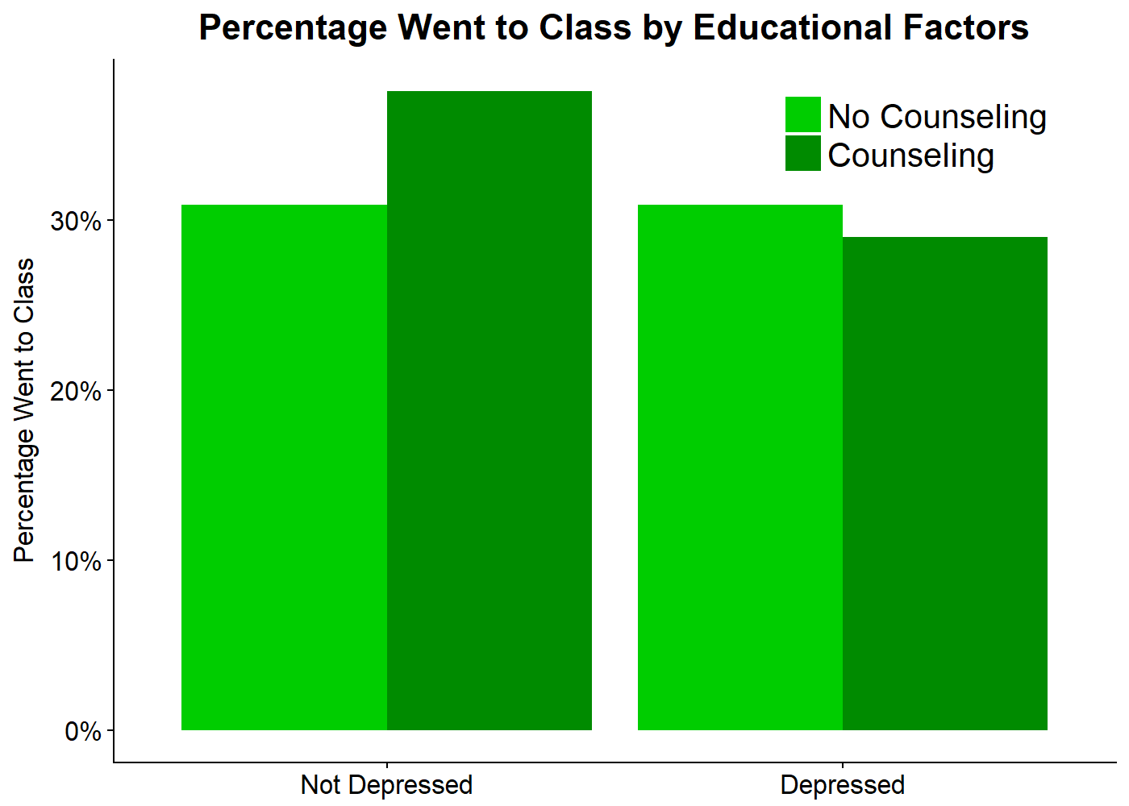
For Whom Does Counseling Intervention Work?
Does counseling intervention predict these outcomes?
Does counseling work particularly well (or poorly) for particular students?
Problem - Counseling interventions are not provided randomly
Propensity Score Analysis to control for non-random counseling
Allows us to say whether counseling caused improvements in outcomes
Sample Results
Risk Factors
Graduation Rate
Counseling

Slide 19
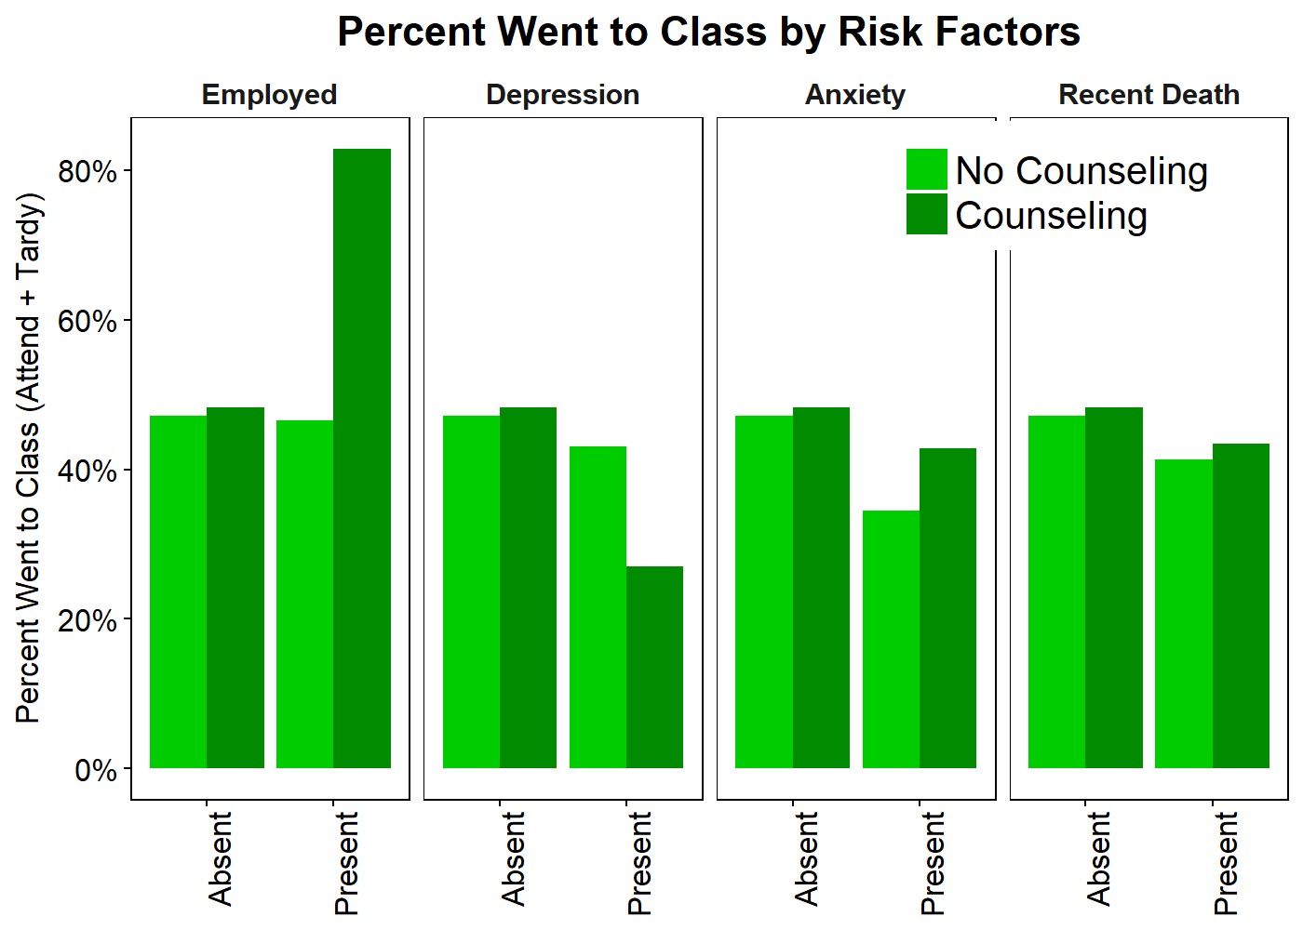
For Whom Does Counseling Intervention Work?
This negative effect of counseling with depression also arose when looking at benchmarks earned
Otherwise the counseling effects were generally small and unreliable
Helped with benchmarks in some analyses and not targeted to students

Slide 20
Conclusions and Recommendations
Generally the BDEA is well equipped to serve a diverse range of students
Several risk factors that we might expect to predict worse outcomes didn’t
Employment Status
Abuse History
Gang involvement
Social Service Utilization
Many others...
Some students to provide additional intervention are
Males
Students with Depression, Anxiety, and Recent Death of a Close Other
Students with depression who received counseling seemed to do worse
It might be helpful to include brief measures of severity
For Depression -- Patient Health Questionnaire - 9
For Anxiety -- Generalized Anxiety Disorder - 7
Students who are starting to develop a pattern of tardiness and absence
Early intervention is likely key
Setting up rewards for attendance may be useful

